Slide 1
Chapter 6: Interoperability
Pingjian Zhang
School of Software Engineering, SCUT
2018

Slide 2
Chapter Outline
What is Interoperability?
Interoperability General Scenario
Tactics for Interoperability
A Design Checklist for Interoperability
Summary

Slide 3

人是社会动物，系统也是
人与人的交流：世界语、机器翻译
信息孤岛、竖井系统
系统的交互：数据层、服务层、业务层、SOA

Slide 4
What is Interoperability?
Interoperability is about the degree to which two or more systems can usefully exchange meaningful information.
Like all quality attributes, interoperability is not a yes-or-no proposition but has shades of meaning.

Slide 5
Interoperability General Scenario
Portion of Scenario | Possible Values
Source | A system
Stimulus | A request to exchange information among system(s).
Artifact | The systems that wish to interoperate
Environment | System(s) wishing to interoperate are discovered at run time or known prior to run time.
Response | One or more of the following: the request is (appropriately) rejected and appropriate entities (people or systems) are notified the request is (appropriately) accepted and information is exchanged successfully the request is logged by one or more of the involved systems
Response Measure | One or more of the following: percentage of information exchanges correctly processed percentage of information exchanges correctly rejected

Slide 6
Sample Concrete Interoperability Scenario
Our vehicle information system sends our current location to the traffic monitoring system. The traffic monitoring system combines our location with other information, overlays this information on a Google Map, and broadcasts it. Our location information is correctly included with a probability of 99.9%.

Slide 7
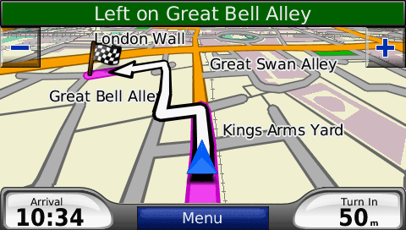

Slide 8
Goal of Interoperability Tactics
For two or more systems to usefully exchange information they must
Know about each other. That is the purpose behind the locate tactics.
Exchange information in a semantically meaningful fashion. That is the purpose behind the manage interfaces tactics. Two aspects of the exchange are
Provide services in the correct sequence
Modify information produced by one actor to a form acceptable to the second actor.

Slide 9
Goal of Interoperability Tactics

Slide 10
Interoperability Tactics

Slide 11
Locate
Discover service: Locate a service through searching a known directory service. There may be multiple levels of indirection in this location process – i.e. a known location points to another location that in turn can be searched for the service.

Slide 12
Manage Interfaces
Orchestrate: uses a control mechanism to coordinate, manage and sequence the invocation of services. Orchestration is used when systems must interact in a complex fashion to accomplish a complex task.
Tailor Interface: add or remove capabilities to an interface such as translation, buffering, or data-smoothing.
Notes:
Orchestrate: mediator pattern; BPEL, ESB
Tailor Interface: decorator pattern, ESB

Slide 13
Standard Is Not Enough For Interoperability
Implementation varies
Standards allow extensions
Standards have a life-cycle
Bad Standards
Conflicting or incompatible standards
Restrictions in rapid development domains

Slide 14
Design for Interoperability
Adopt suitable architectural patterns and tactics.
Design a dedicated interoperability view if necessary.

Slide 15
Design for Interoperability
Determine which responsibilities will need to interoperate with other systems.
Ensure that responsibilities have been allocated to
accept the request
exchange information
reject the request
notify appropriate entities (people or systems)
log the request (for audit trail)

Slide 16
Design for Interoperability
Ensure that the coordination mechanisms can meet the critical quality attribute requirements.
Volume of traffic on the network.
Timeliness of the messages being sent by your systems.
Currency of the messages being sent by your systems
Jitter of the messages arrival times.
Ensure protocols consistence.

Slide 17
Design for Interoperability
Determine the syntax and semantics of the major data abstractions that may be exchanged among interoperating systems.
Ensure that these major data abstractions are consistent with data from the interoperating systems.
Confidential data -- transformations

Slide 18
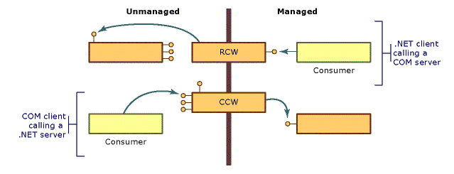
Case Study: .NET

Slide 19
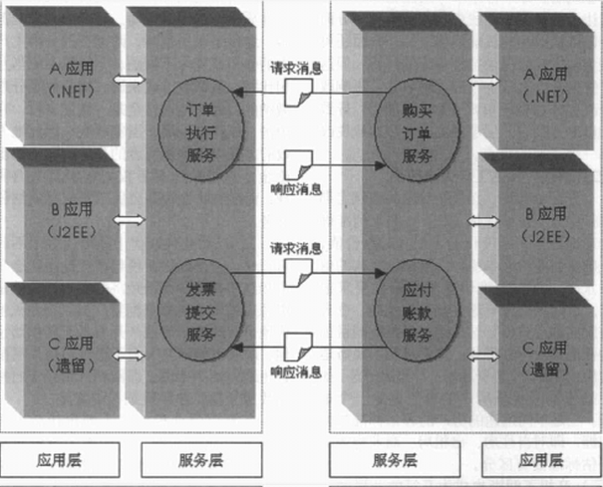
Case Study: B2B

Slide 20
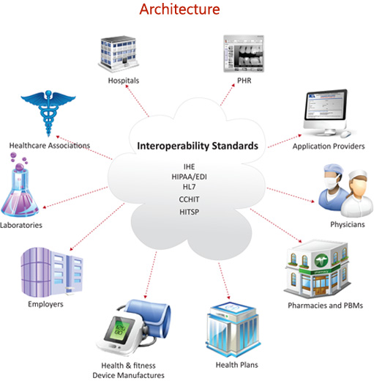

Slide 21
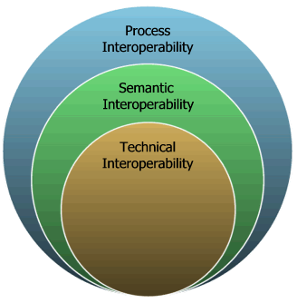

Slide 22
Summary
Interoperability refers to the ability of systems to usefully exchange information.
Achieving interoperability involves the relevant systems locating each other and then managing the interfaces so that they can exchange information.

